Slide 1
G-Quadruplex - GO terms

Slide 2
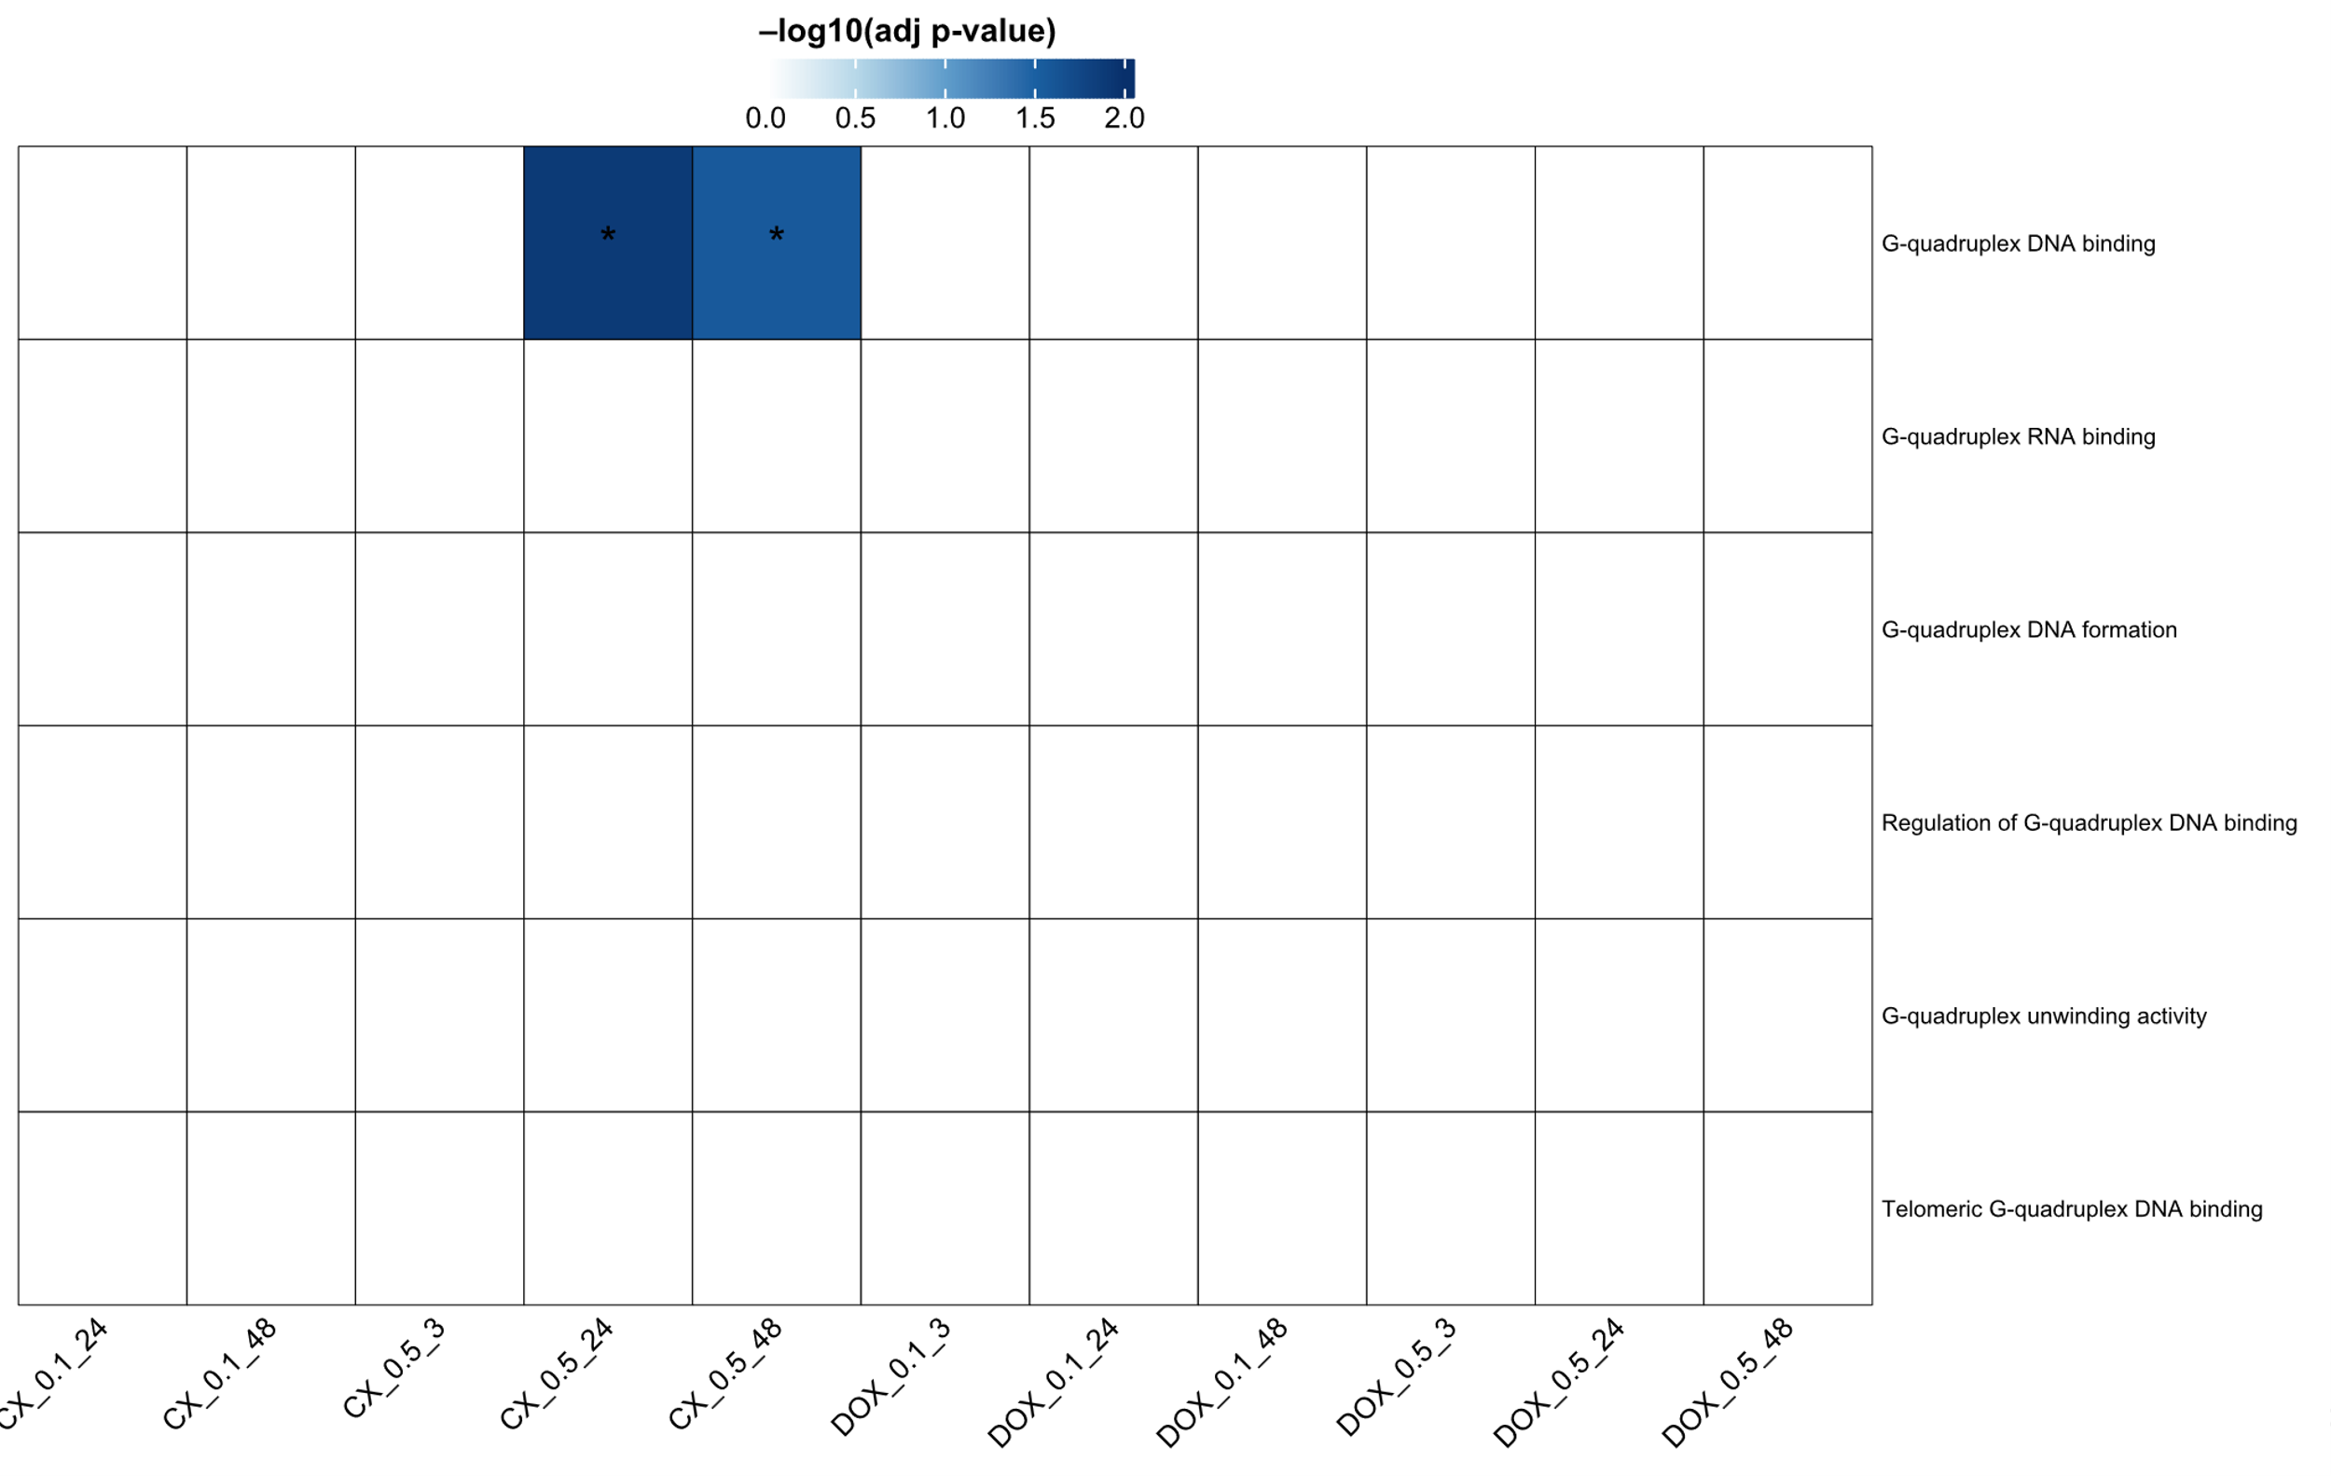
G-Quadruplex - GO terms

